Slide 1
AI Workplace Productivity Assistant
AI Project
Presented by:
Patience Ramaboe

Slide 2
Problem Statement
Professionals spend significant time on repetitive workplace tasks such as:
- Writing emails
- Summarizing meetings
- Planning tasks
- Conducting research
This project aims to improve productivity through AI automation.

Slide 3
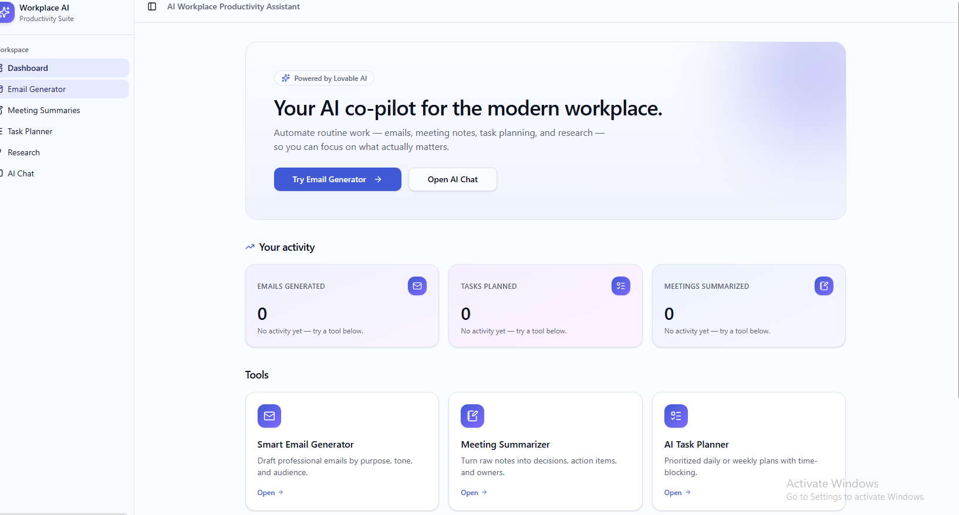
Solution Overview
The AI Workplace Productivity Assistant is a modern AI-powered web application designed to automate workplace productivity tasks using artificial intelligence and prompt engineering techniques.

Slide 4
Features
Features:
- Smart Email Generator
- Meeting Notes Summarizer
- AI Task Planner
- AI Research Assistant
- AI Chatbot Interface

Slide 5
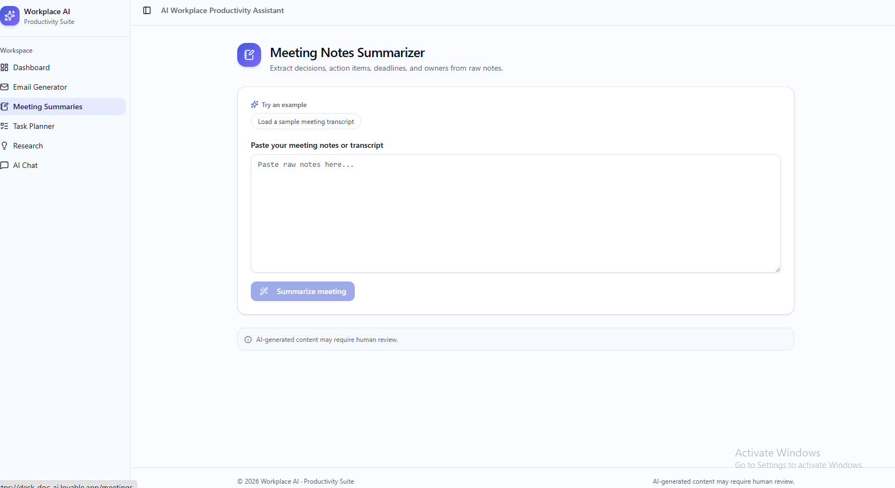
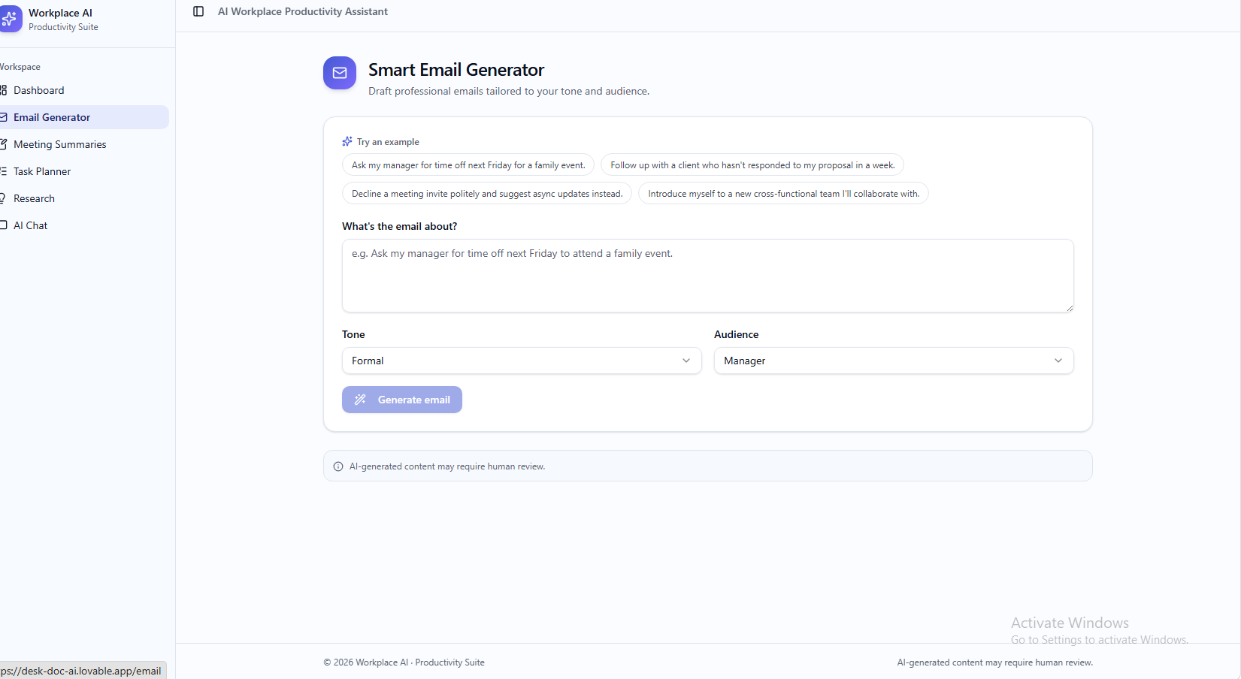
Features

Slide 6
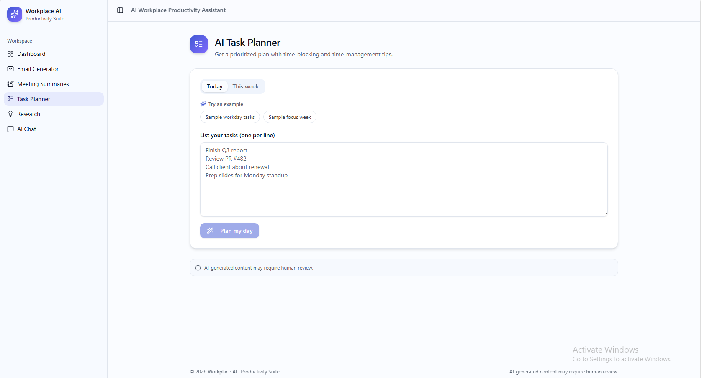
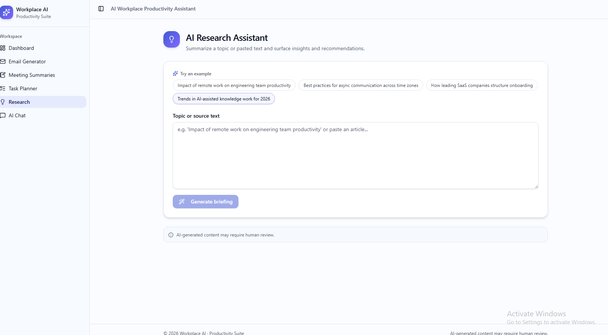
Features

Slide 7
Tools & Technologies
Tools Used:
- Lovable AI
- ChatGPT
- GitHub
- Prompt Engineering
- Modern SaaS UI Design

Slide 8
Prompt Engineering
Structured prompts were used to improve:
- AI accuracy
- Professional tone
- Clarity
- Productivity-focused outputs

Slide 9
Responsible AI
Responsible AI Considerations:
- Human review is recommended
- Avoid confidential information
- AI may generate inaccurate outputs
- Ethical AI usage was considered
"AI-generated content may require human review."

Slide 10
Conclusion
The project successfully demonstrates how AI can improve workplace productivity by automating repetitive tasks using modern AI tools and prompt engineering techniques.
https://desk-doc-ai.lovable.app

